Slide 1
Motion
Motion and Objects

Slide 2
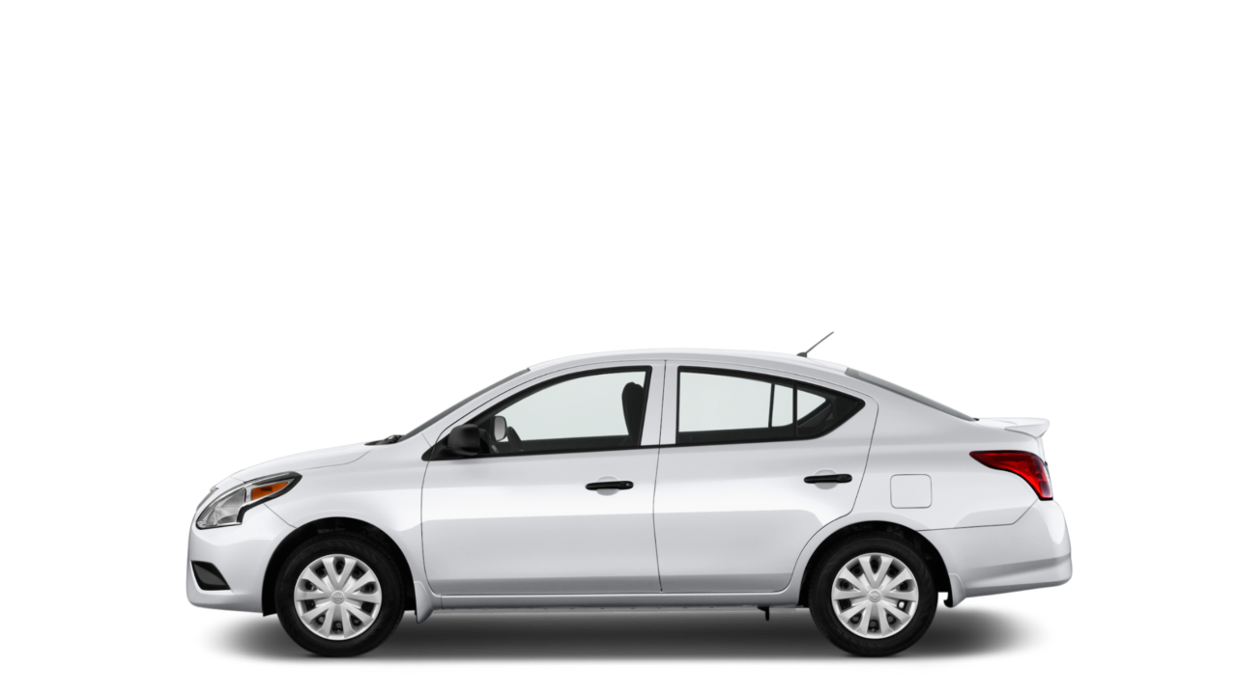

Slide 3

SPEED

Slide 4
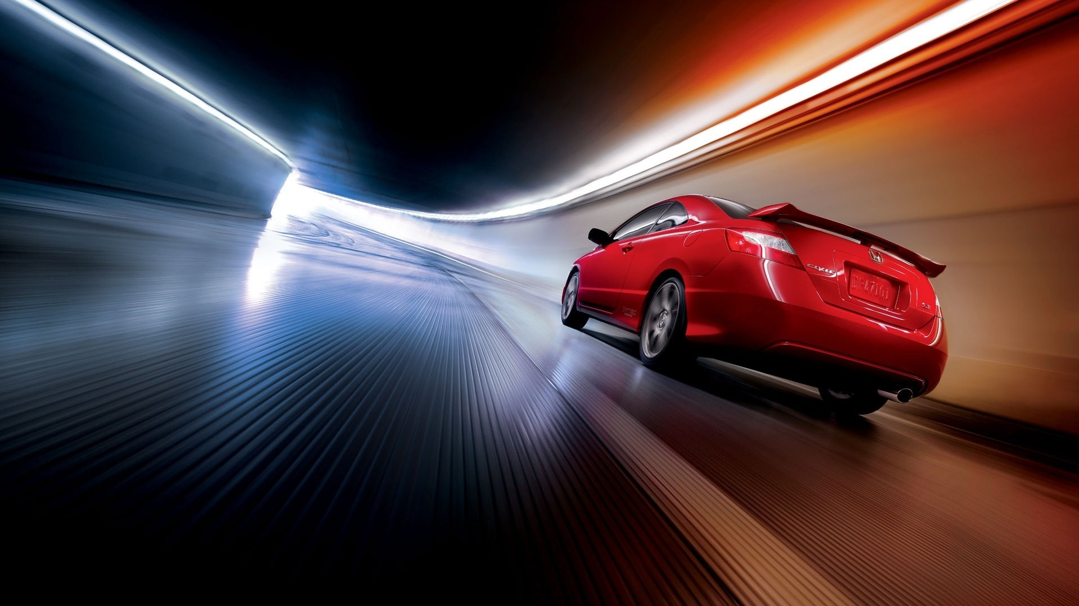

Slide 5

30 MPH

Slide 6
HEADING
DIRECTION
30 MPH

Slide 7
Vector (Heading)
speed / magnitude
y speed
x speed

Slide 8
The Numbers So Far (4)
Position: X and Y
Speed: X and Y
y speed
x speed

Slide 9
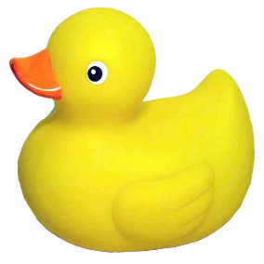
Pseudocode
Make variables for circle (position, speed)
Forever in draw:
Background
Draw the circle
Add speed to position
Notes:
640 for width

Slide 10
Pseudocode
Make variables for circle (position, speed)
Forever in draw:
Background
Draw the circle
Add speed to position
If we hit the bottom edge:
bounce

Slide 12
Pseudocode
Make variables for circle (position, speed)
Forever in draw:
Background
Draw the circle
Add speed to position
If we hit the bottom edge:
bounce

Slide 13
Pseudocode
Make variables for circle (position, speed)
Forever in draw:
Background
Draw the circle
Add speed to position
If we hit the bottom edge:
bounce
If we hit the right edge:
bounce

Slide 14
Pseudocode
Make variables for circle (position, speed)
Forever in draw:
Background
Draw the circle
Add speed to position
If we hit the bottom edge:
bounce
If we hit the right edge:
bounce
If we hit the top edge:
bounce
If we hit the left edge:
bounce
Notes:
Take a break?

Slide 15
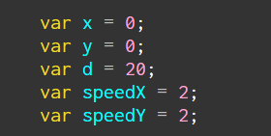
Objects, Take 2

Slide 16
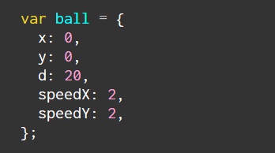
Objects, Take 2

Slide 17
Different Modes
Set a variable at the top: mode
Use if (mode == #) to change behavior in the code

Slide 18
Modes For Fun
Square instead of circle
Leave a trail behind you
Randomly change the size of the shape
Gravity

Slide 19
Gravity
position
speed

Slide 20
Gravity
position
speed
acceleration

Slide 21
Gravity
position
speed
acceleration

Slide 22
Gravity (a hint for future classes)
position
speed
acceleration
DERIVATIVES
INTEGRALS

Slide 23
Modes For Fun
Square instead of circle
Leave a trail behind you
Randomly change the size of the shape
Gravity

